Slide 1
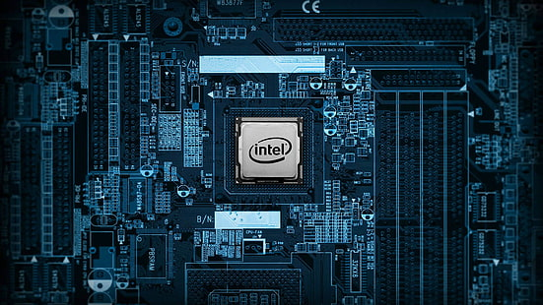
Understanding Hardware: The Physical Components
(Central Processing Unit (CPU))-----
The brain of the computer, responsible for performing calculation and instruction.
Memory(RAM)----Temporary storage for data the CPU is actively using. Allowing for fast access.
Storage Devices ---- permanent storage for data , such as hard drives,solid-state drives, and flash drives.

Slide 2
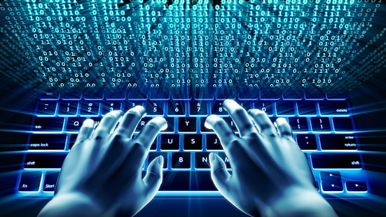
Exploring Software: The Instructions and programs ------1.Operating system(OS)The foundation of a computer , managing resources and providing a user interface.
2 Applications ---programs designed to perform specific tasks, like word processing .web browsing . Or gaming .
3.---- Drivers – software that enables the OS to communicate with hardware components.

Slide 3
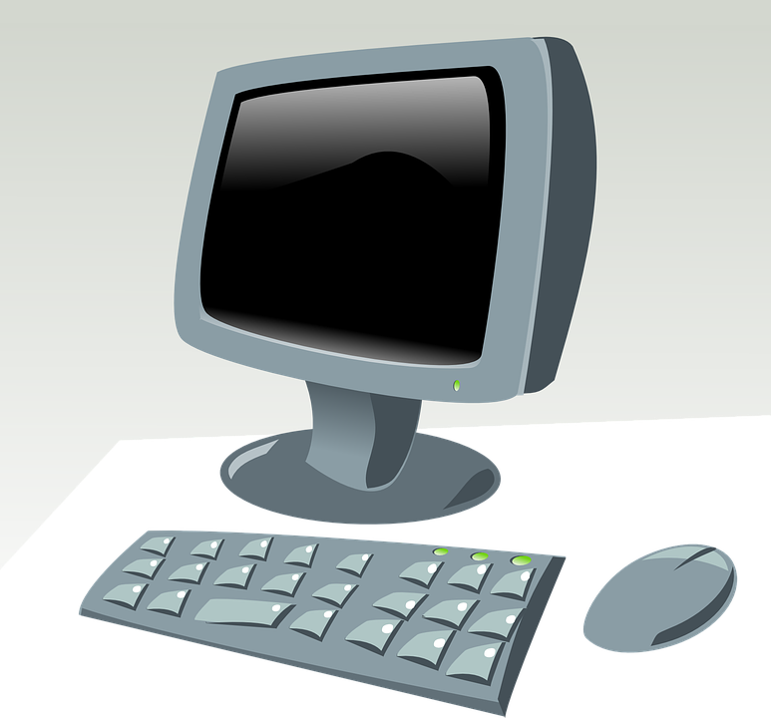
Input device :communicating with the computer .
1—Keyboard –used to enter text ,numbers commands.
2--- Mouse – used to control. The cursor on the screen , interact with object , and navigate menus.
3--- Touchscreen—Allows for direct interaction with the computer using touch gestures.

Slide 4
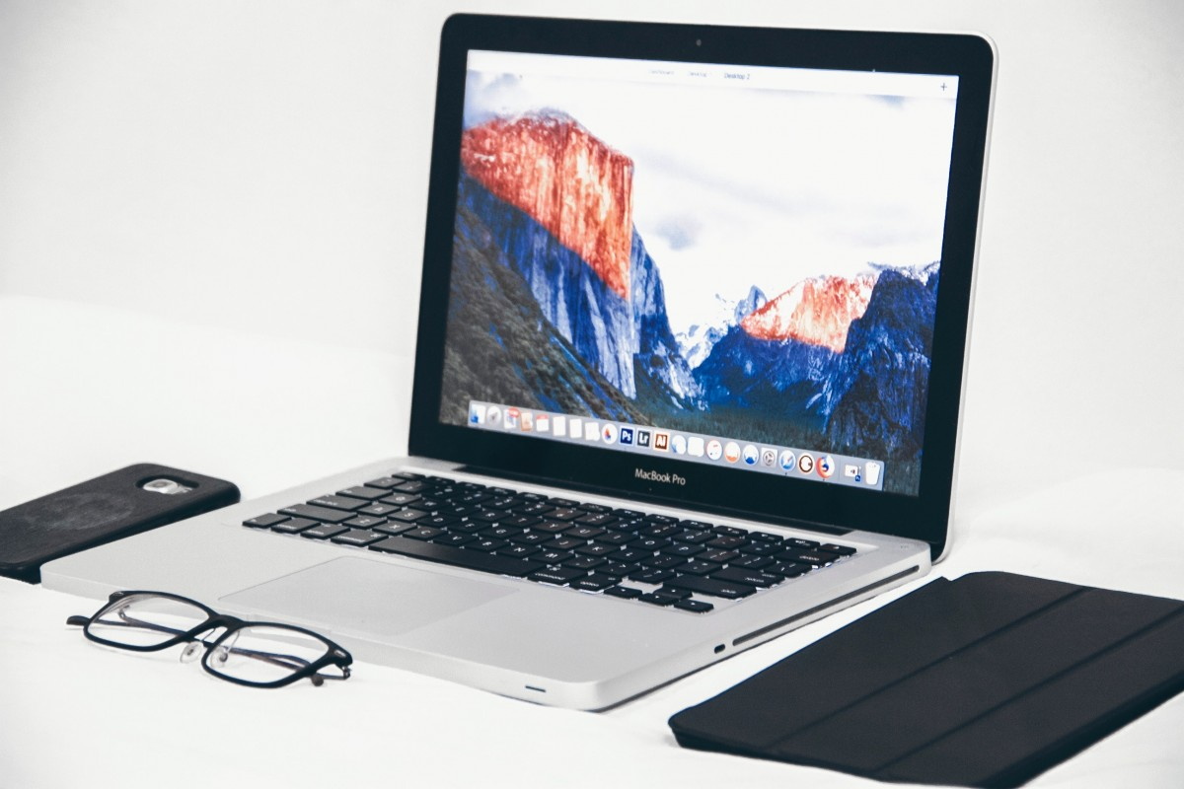
Output Devices: Receiving
Information from the Computer
Monitor
Displays visual output, including text, images, and videos.
Speakers
Produce audio output, such as music, sound effects, and voice.
Printer
Creates physical copies of documents and images.

Slide 5
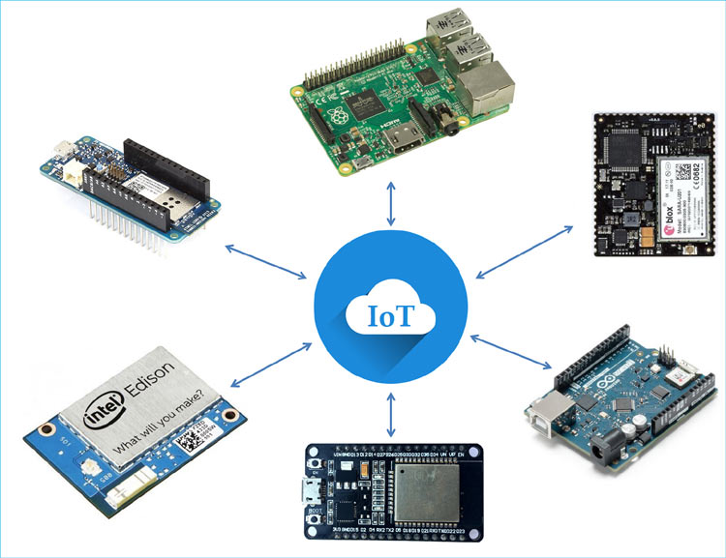
The Relationship Between
Hardware and Software
Hardware
Provides the physical components and infrastructure
Software
Provides the instructions and programs that tell the
hardware what to do.
Interaction
Software relies on hardware to function, and hardware is
controlled by software.
This Photo by Unknown Author is licensed under CC BY-SA-NC

Slide 6
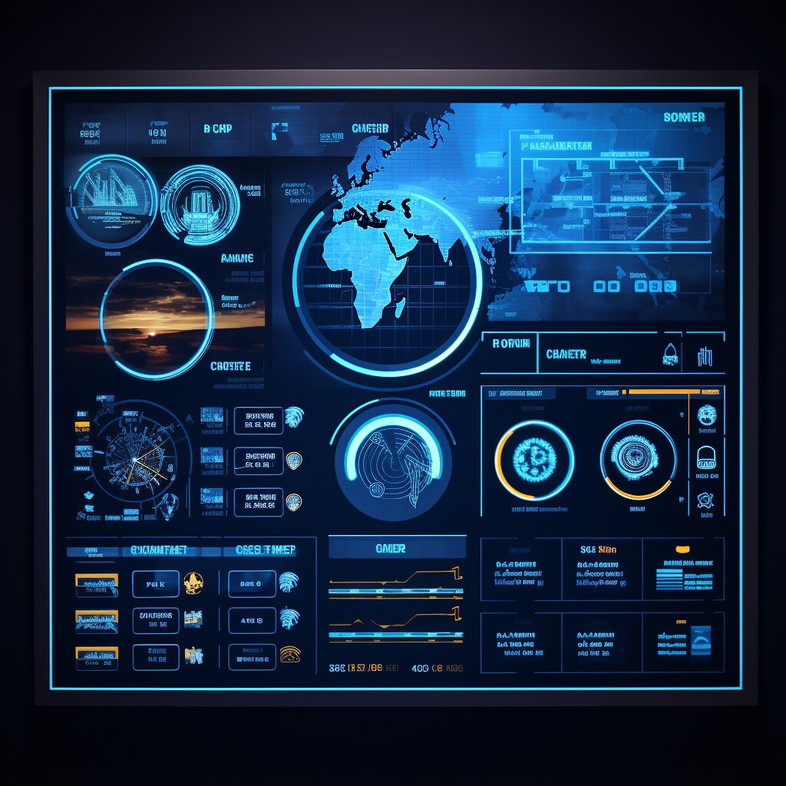
Putting it Together: A Simple Computer System
2. Processing
Input
The CPU interprets and executes instructions from software,
Information is entered through input devices like the keyboard and
manipulating data.
mouse
4> Storage
3.Output
Data is stored permanently on storage devices for future use.
Processed information is displayed through output devices like the
monitor and speakers.
This Photo by Unknown Author is licensed under CC BY-SA-NC

Slide 7
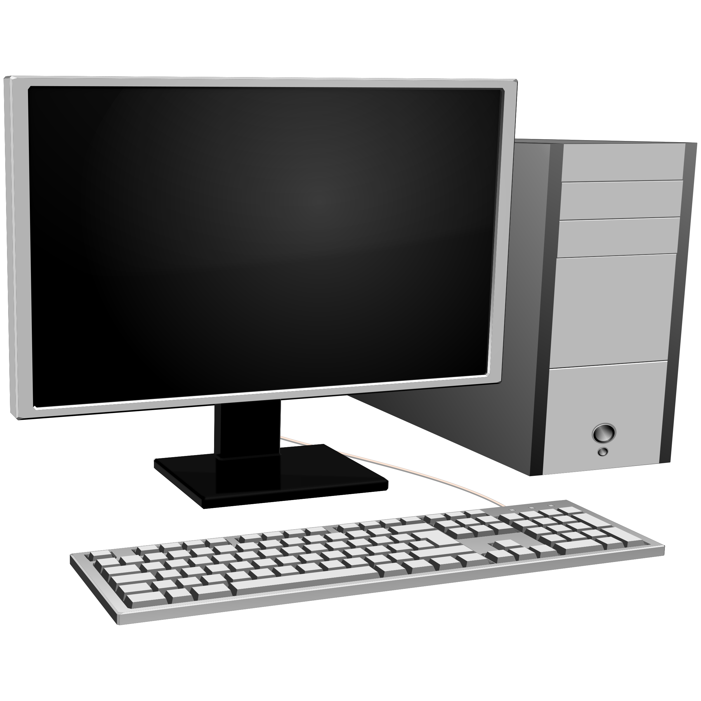
What is computer
Computer is an electronics device which is using for calculation and analyse data or information …..

